Slide 1


PM SCHOOL CHALLENGE
By Digvijaya Satapathy

Slide 2

About Minis by Swiggy
Minis by Swiggy is a self-serve platform that allows businesses of all sizes to set up their own online store and reach out and sell to customers - both local and pan India.
It is a one-stop solution for businesses that want to sell online
Problem Statement
To drive traction and improve adoption and engagement metrics for Minis by Swiggy

Slide 3
Easy setup: Minis can be set up in minutes, with no technical know-how required.
Customizable storefronts: Businesses can create their own storefronts with their own branding and product catalogs
Seamless payments and logistics: Minis integrates with popular payment and logistics partners, making it easy for businesses to accept payments and fulfill orders.
Zero commissions: Minis does not charge any commissions on sales, so businesses can keep all their profits
Complete control: Businesses have complete control over their brand, orders, and customer details
Offerings by Minis

Slide 4

Competitor Analysis
 | Shopify | Minis by Swiggy
Ease of use | More complex, but offers more features and customization options | Easier to set up and use, but with fewer features and customization options
Features | Comprehensive range of features, including customizable store design, product management, payment processing, shipping and fulfillment, and marketing tools | More limited range of features, but includes all of the essentials for setting up and running an online store
Pricing | Monthly subscription fee, plus transaction fees | Zero commission structure, with a one-time registration fee
Target audience | Businesses of all sizes, from small businesses to large enterprises | Small businesses and startups that are looking for an affordable and easy-to-use e-commerce platform
Reviews & Downloads (Play Store) | 4.1 | 4.2
With 31.2K reviews
With just 311 reviews

Slide 5

GTM Strategy

Slide 6
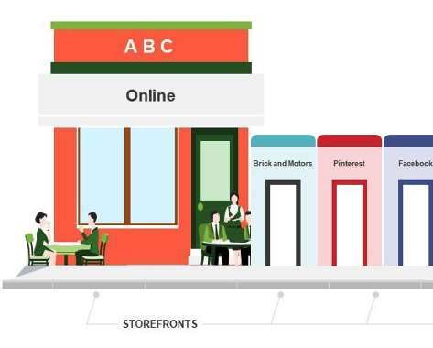
Minis by Swiggy should focus on Single Platform -> Every platform -> Any Device Approach

Slide 7
Brand
Brand Awareness & Marketing: Spread awareness about Minis and make branded advertising videos
Identify and target
Targeted Marketing: Identify and target potential customers and existing Swiggy customers through online advertising and partnerships.
Marketing
E-mail Marketing : Target the existing customers by sending emails and whatsapp text highlighting the product features for SMBs.
Create
Educational Content: Create content on the platform and blog posts about the advantages of the platform. Create youtube educational content and leverage the platform for young audience.
Launch
Referral Program: Launch a referral program to encourage existing customers to refer friends and family and earn reward points
Improve
Improve rating on google play & App Store: Conduct training for support staff to face adverse situations head-on and give out practical solutions to customers
Awarness
Train your customer support team to educate users about these new offerings

Slide 8

Monetization Strategy
Subscription Solutions
Merchant Solutions

Slide 9
Subscription Solutions
Minis has registration plans for merchants. This can be designed to subscription based plans to meet the needs of current and prospective merchants. Offering different service and pricing levels allows entrepreneurs to scale without leaving the platform: as a merchant upgrades to the higher-priced options, they receive more powerful tools.
Minis can offer more ‘Lite’ service plan allowing website owners to add a minis store to their existing web properties.
Minis can share the revenue with app and theme developer partners

Slide 10
Merchant Solutions
Advertising: When merchants click on the apps being advertised by its partners
Minis Capital: Merchants can take loans, and access Cash advances through Minis Capital to grow their businesses. They can charge a fixed borrowing cost to the loan. The fixed borrowing cost is the fee that the user/merchant pays to obtain a loan. To repay the loan, the merchant can pay a percentage of the daily sales revenue to Shopify Capital until the full remit has been remitted.
Shipping: It allows merchants to manage their shipments through available shipping partners on Swiggy.
POS: Minis by Swiggy sales channel lets merchants sell their products and accept payments in person from a mobile device in a physical or retail setting.
Email: It is an email marketing tool to enable merchants to manage their marketing campaigns.

Slide 11
Product Strategy for Minimum Viable Product
Feature Suggestions
Wireframing

Slide 12
Feature Suggestions
Raising Capital : Merchants can apply and take loans, and access Cash advances to grow their businesses.
POS: Distributing POS machines to merchants at lower fixed costs and variable costs

Slide 13
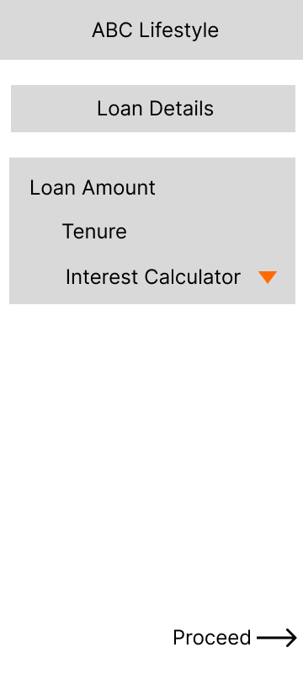
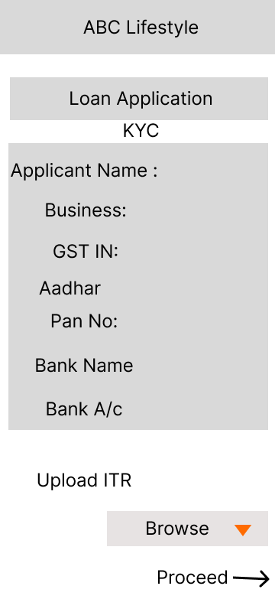
Wireframes for Minis Capital Loan

Slide 14
Customer Engagement: High customer engagement indicates that users find value in the platform and return frequently, leading to increased cross-selling opportunities
Revenue Growth: Positive revenue growth validates the viability of the expansion and demonstrates higher return on investment
Cross-Selling: high cross-selling rate indicates that Minis by Swiggy effectively leverages its existing customer base for new offerings
Success Metric

Slide 15
Short-term: Focussing on Core Business
Platform
Payments
Shipping
Capital
Medium-term: Looking forward to expansion
International footprint
Retail expansion
POS
Long-term: Making the platform more ambitious
Introducing Wallet payments
Building fulfillment network
Growing wholesale business
Growth Path

Slide 16
Thank You
Digvijaya Satapathy

